Slide 1

DataDive Week 5:
Evaluating ML Models
SheffDataSoc

Slide 2

Datasoc Promo!
Upcoming social: Pub Quiz @ the Cavendish (West St), Thu 12th March 7-10pm. It’s free to attend, so please do come along!
DataDive Sign Up is live!
https://tinyurl.com/datadivesignup
Check out Datasoc on instagram
(@sheffdatasoc) for updates and information on our events!

Slide 3
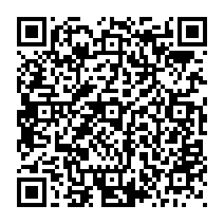
Session Outline
Recap: What is an AI Model?
Why Do We Evaluate Models?
Aligning Models With Our Objectives
Common Evaluation Metrics
Overfitting
Creating Ethical Models
Questions to Ask When Building Models
Typical Evaluation Workflow
Access the resources for today’s session:
https://github.com/sheffdatasoc/datadive-resources
https://tinyurl.com/uostrain

Slide 4
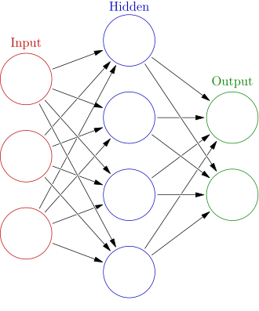

Recap: What is an AI Model?
AI models solve problems by learning and exploiting patterns in data
Dog
The primary use case of models is making predictions.
How do we know if they are any good?
Notes:
A model detects the patterns in data. If we have bad data, bad model.

Slide 5
Why Do We Evaluate Models?
Training a model doesn’t mean it will work well in the real world.
Evaluation helps us answer three key questions:
Is it accurate?
Does it achieve the goal we care about?
Is it safe and fair to use?
A model might look great in training but poor performance in real scenarios. For example, a spam email classifier trained on poor data might let 80% of spam emails through in a real scenario.

Slide 6


Alignment With Objective
The single most important question to ask is ‘Are we measuring the thing that actually matters?’
A model can look amazing in training, but if it is amazing on the wrong thing it is useless!

Slide 7

Example: Alignment With Objective
Goal: Detect cancer in scans Metric used: Accuracy
Problem: If only 1% of patients have cancer, a model that always predicts “no cancer” will get 99% accuracy but be completely useless.
Better metrics:
Recall (sensitivity) – how many real cases we detect
Precision – how often our alerts are correct
Key lesson: Metrics must match the real-world objective.

Slide 8
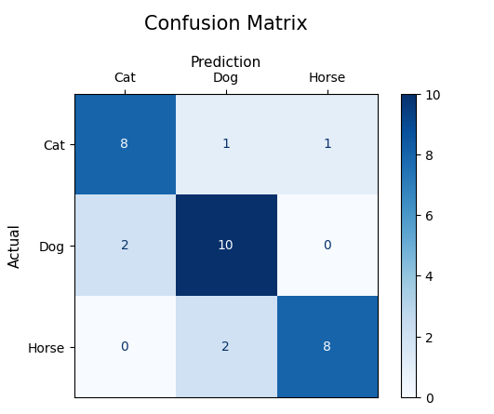
Common Evaluation Metrics
Accuracy: Percentage of correct predictions
Precision: Of the positive predictions, how many were correct?
Recall: Of the real positive cases, how many did the model find?
There are often tradeoffs between metrics, for example precision and recall. A higher Recall often means lower Precision.
Notes:
Why is each important? Tradeoffs. Use visuals!

Slide 9
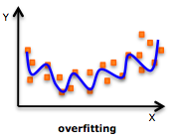
Overfitting
A model might perform well on training data but poorly in the real world
This is called overfitting.
We solve this primarily through splitting our training data into ‘Test’ and ‘Train’ sets at an 20/80 ratio.
Test and Train data are exactly that - we train the model with one set, we test the models performance with the other.
We want to evaluate performance on data the model has never seen. This makes sure the model is general.
Notes:
Model performance

Slide 10
Building Ethical Models
Building good models isn’t just about absolute performance.
We must also ask:
Is this model fair across groups?
Could it cause harm?
Does it respect privacy?
Are the predictions explainable?
A hiring model may perform well overall but unfairly disadvantage certain groups
Notes:
Why is each important? Tradeoffs.

Slide 11
Case Study: Amazon
Amazon hiring bias case study.
Notes:
Why is each important? Tradeoffs.

Slide 12
Practical Questions to Ask When Evaluating Models
Does the metric match the real goal?
Does the performance hold on unseen data?
Are certain groups affected differently?
What are the consequences of errors?
Can we explain the models decisions?
Your models will be used by real people
Notes:
Why is each important? Tradeoffs.

Slide 13
Evaluation Workflow
Train Model
Test on Unseen Data
Calculate Metrics
Check Bias against subgroups (black, white, male, female, etc)
Review Ethical Risks
Decide if the Model is Safe to Deploy
Remember - you can always retrain the model!
The issue stated above can likely be fixed by changing one or more of your:
Dataset
Objective
Model Type
Notes:
Why is each important? Tradeoffs.

Slide 14
Key Takeaways
A good model isn’t just accurate - it is aligned with the objective, performs well on new data and safe to use in the real world.
Goals of training a production level model:
Align with project goals
Performs well on new data
Ethical and safe to use the in real world
Notes:
Why is each important? Tradeoffs.

Slide 15

Notebooks
https://github.com/sheffdatasoc/datadive-resources
https://tinyurl.com/uosevaluation

